Slide 1

FINITE STATE MACHINES (FSMs)
Dr. Konstantinos Tatas

Slide 2
Finite State Machine
A generic model for sequential circuits used in sequential circuit design

Slide 3
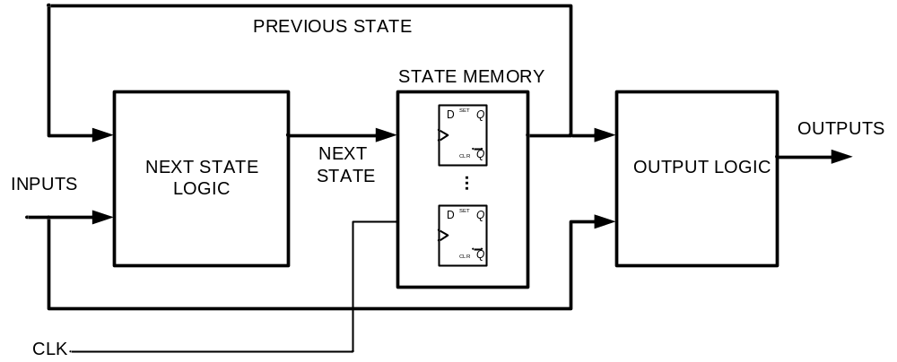
Finite state machine block diagram
State memory: Set of n flip-flops that hold the state of the machine (up to 2^n distinct states)
Next state logic: Combinational circuit that determines the next state as a function of the current state and the input
Output logic: Combinational circuit that determines the output as a function of the current state and the input

Slide 4
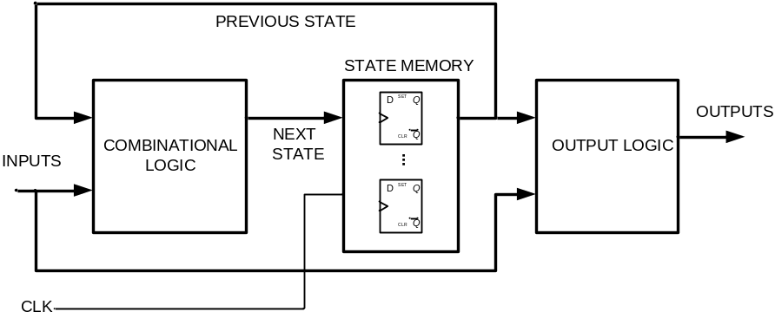
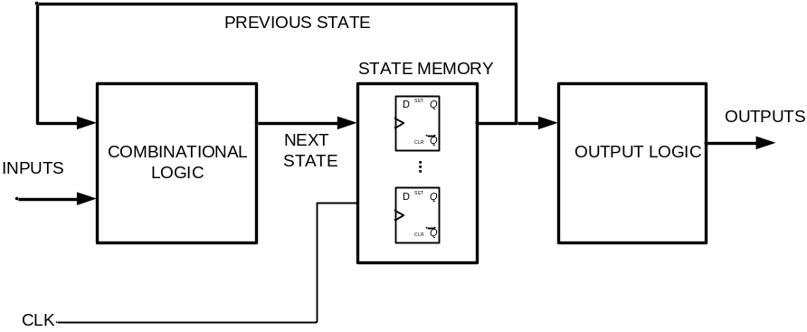
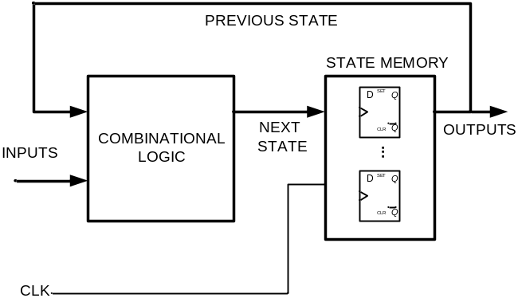
Finite State Machine types
Mealy machine: The output depends on the current state and input
Moore machine: The output depends only on the current state
  State = output state machine: A Moore type FSM where the current state is the output

Slide 5
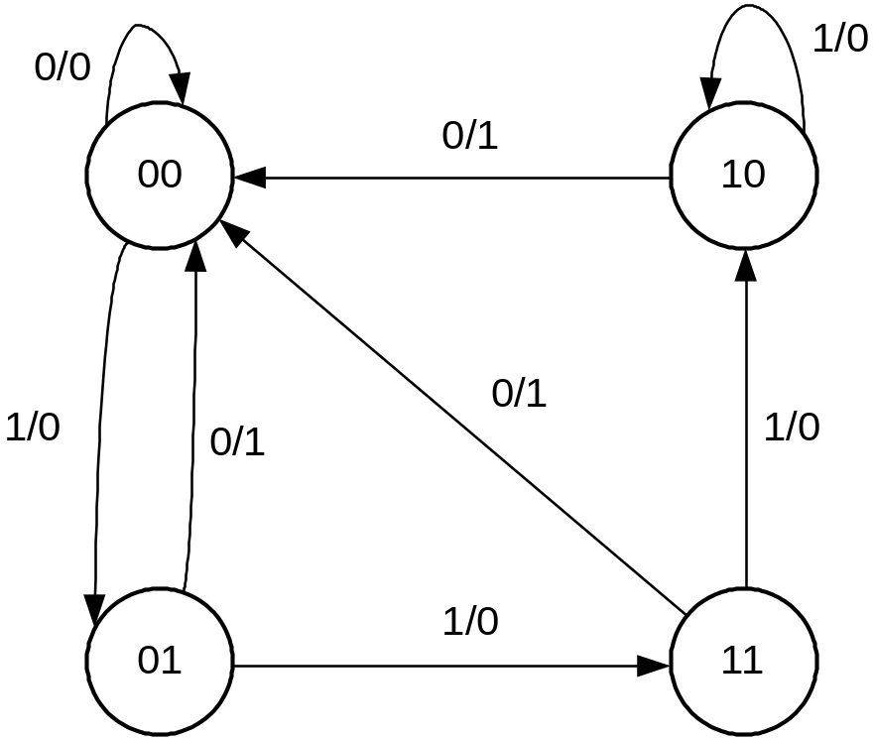
State diagram
A state diagram represents the states as circles and the transitions between them as arrows annotated with inputs and outputs

Slide 6
Analysis of FSMs with D flip-flops
Determine the next state and output functions
Use the functions to create a state/output table that specifies every possible next state and output for any combination of current state and input

Slide 7
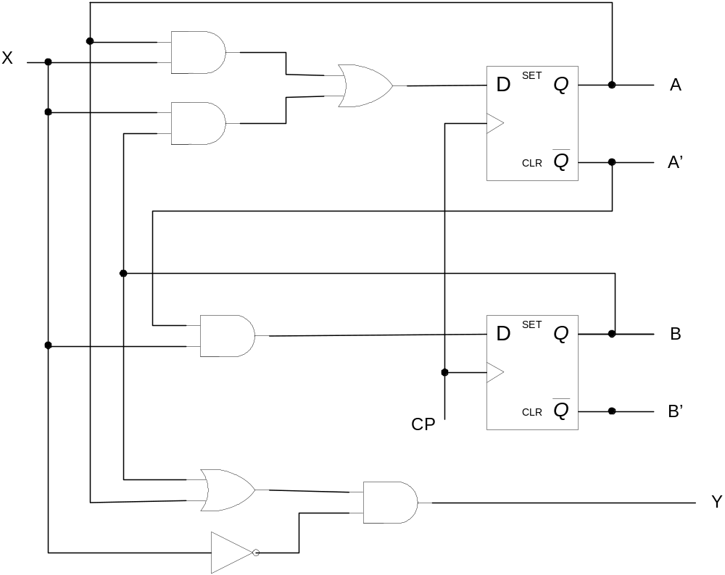
EXAMPLE

Slide 8
Next state equations and state table for example
A
B
x
A+
B+
y
A+=Ax+Bx
B+=A΄x
Y=(A+B)x΄
0
0
0
0
0
0
0
0
1
0
1
0
0
1
0
0
0
1
0
1
1
1
1
0
1
0
0
0
0
1
1
0
1
1
0
0
1
1
0
0
0
1
1
1
1
1
0
0

Slide 9
A+=Ax+Bx
B+=A΄x
Y=(A+B)x΄
A
B
x
A+
B+
y
0
0
0
0
0
1
0
1
0
0
1
1
1
0
0
1
0
1
1
1
0
1
1
1

Slide 10
Sequential circuit design methodology
From the description of the functionality or the state/timing diagram find the state table
Encode the states if the state table contains letters
Find the necessary number of flip-flops
Select flip/flop type
From the state table, find the excitation tables and output tables
Using Karnaugh maps find the flip-flop input logic expressions
Draw the circuit logic diagram

Slide 11
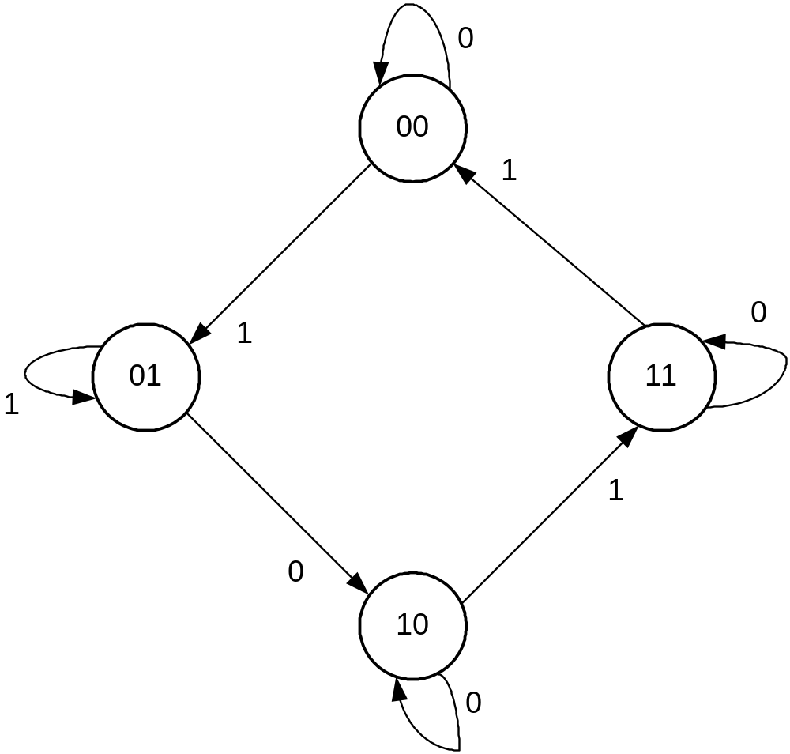
Example: Design the sequential circuit of the following state diagram

Slide 12
State/excitation table
A
B
x
A+
B+
DA
DB
JA
KA
JB
KB
0
0
0
0
0
1
0
1
0
0
1
1
1
0
0
1
0
1
1
1
0
1
1
1

Slide 13
Karnaugh maps for combinational circuit

Slide 14
Circuit logic diagram

Slide 15
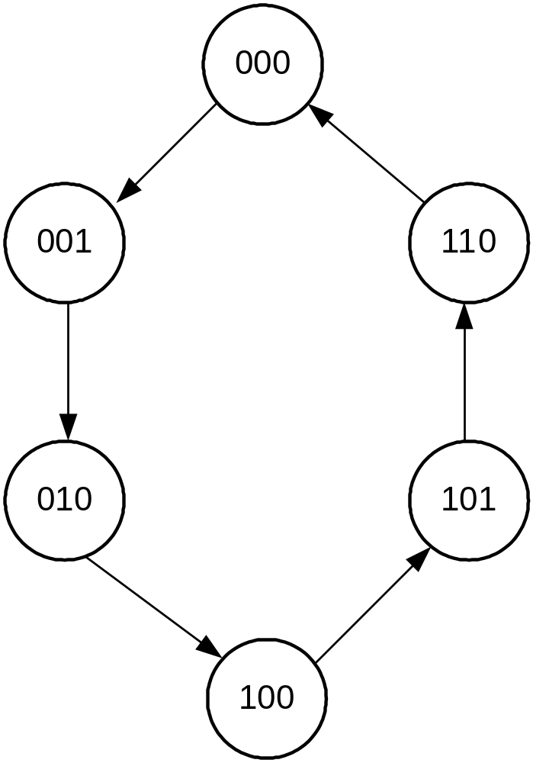
Example: counter

Slide 16
Self-correcting state machines
The previous example did not include two possible states “011” and “111”. If the counter unexpectedly falls into one of those states there are two possibilities:
  The counter will recover by entering a valid state after a finite number of cycles (self-correcting)
  The counter will stay in a non-valid state until the f/fs are reset (not self-correcting)
Finite state machines should be designed to be self correcting by assigning non-valid states to a valid next state (no don’t cares in the excitation table)

Slide 17
Example
Design a self-correcting one-digit BCD counter

Slide 18
Example
Design the circuit for the left and right indicator lights in a car.
Inputs:
  Clock: Frequency equal to the flashing rate
  Reset: for initializing flip-flops
  Left, Right: normally zero, remain one for the duration of the turn
  Emergency: Rising edge active, both lights should be flashing

